Slide 1
Apache Tomcat

Slide 2
Session Objective
Apache tomcat an Introduction

Slide 3

Apache tomcat an Introduction
Apache Tomcat is an open-source web container and Java Servlet Container developed by the Apache Software Foundation

Slide 4
Tomcat Directory Structure

Slide 5
Tomcat Directory
Directory | Description
bin | Tomcat's binaries and startup scripts
conf | global configuration applicable to all the webapps.
lib | Keeps the JAR-file that are available to all webapps.
logs | contains the engine log file Catalina
work | contains the translated servlet source files and classes of JSP/JSF.
temp | temporary files.
Notes:
Directories of Tomcat :
bin: Tomcat's binaries and startup scripts.
conf: global configuration applicable to all the webapps. The default installation provides:
One Policy File: catalina.policy for specifying security policy.
Two Properties Files: catalina.properties and logging.properties,
Four Configuration XML Files: server.xml (Tomcat main configuration file), web.xml (global web application deployment descriptors), context.xml (global Tomcat-specific configuration options) and tomcat-users.xml (a database of user, password and role for authentication and access control).
The conf also contain a sub-directory for each engine, e.g., Catalina, which in turn contains a sub-sub-directory for each of its hosts, e.g., localhost. You can place the host-specific context information (similar to context.xml, but named as webapp.xml for each webapp under the host).
lib: Keeps the JAR-file that are available to all webapps. The default installation include servlet-api.jar (Servlet), jasper.jar (JSP) and jasper-el.jar (EL). You may also keep the JAR files of external package here, such as MySQL JDBC driver (mysql-connector-java-5.1.{xx}-bin.jar) and JSTL (jstl.jar and standard.jar).
logs: contains the engine logfile Catalina.{yyyy-mm-dd}.log, host logfile localhost.{yyyy-mm-dd}.log, and other application logfiles such as manger and host-manager. The access log (created by the AccessLogValve) is also kept here.
webapps: the default appBase - web applications base directory of the host localhost.
work: contains the translated servlet source files and classes of JSP/JSF. Organized in hierarchy of engine name (Catalina), host name (localhost), webapp name, followed by the Java classes package structure.
temp: temporary files.

Slide 6
Base and Home Directories
The directory TOMCAT-HOME contains executables and libraries required for the server launching, running and stopping
This directory is placed under /usr/local/…
The directory TOMCAT-BASE contains the Web-site content, Web applications and configuration data
This directory is placed under your home directory

Slide 7
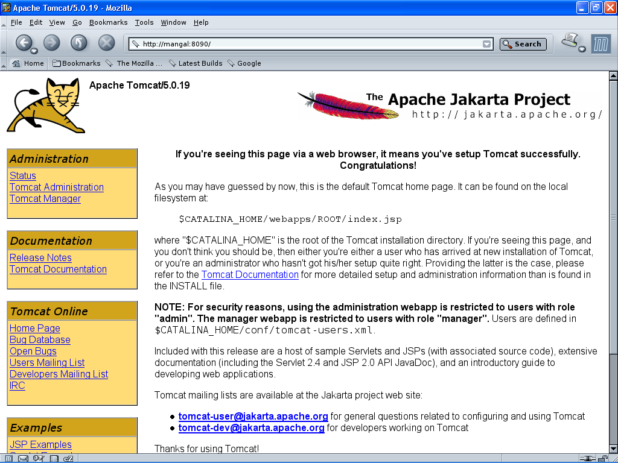

Slide 8
Choosing a port for Tomcat
In the file $CATALINA_HOME/conf/server.xml you will find the element Connector of Service “Catalina”
Choose a port (greater than 1024) and change the value of the port attribute to your chosen one:
<Server>
…
<Service name="Catalina”>
<Connector port="8090"/>
…
</Service>
…
</Server>

Slide 9
Webapp-Specific Configuration Files
The configuration files specific to a webapp:
a) WEB-INF\web.xml;
b) META-INF\context.xml.

Slide 10
Web Application Deployment Descriptors
The "web.xml" contains the deployment descriptors.
There are two sets of web.xml:
<CATALINA_HOME>\conf\web.xml: applicable to ALL webapps.
ContextRoot \WEB-INF\web.xml: applicable to the specific web context.

Slide 11
Running Tomcat
Tomcat "manager" webapp allows you to deploy a new web application and start, stop, reload or un-deploy an existing one, without having to shut down and restart the server, in a production environment.
To enable Tomcat's manager, edit "<CATALINA_HOME>\conf\tomcat-users.xml" to include a role called "manager-gui" and a user with this role. You may also assign other roles, such as admin-gui for accessing the Tomcat "Host Manager".

Slide 12
Apache Command for Linux
Go to apache folder in Linux command prompt
./bin/startup.sh - ( To start the server)
./bin/shutdown.sh – (To Shutdown the server)
rm –rf logs/* -(to remove the history in log file)
tail –f logs/* -(to move the cursor to end )

Slide 13
Server start and stop
In Windows Environment:
To Start server: <Tomcat Root>/bin>Tomcat.exe start
To Stop server: <Tomcat Root>/bin>Tomcat.exe stop

